Slide 1

HIV and Co-morbidities: Kaposi's Sarcoma. State of the ART and beyond
Dr. Patricia Volkow
@TwitterHandle
Share your thoughts on this presentation with #IAS2019

Slide 2
Conflict of interest
Participated on Advisory boards in the last five years.
Abbvie
ViiV
Gilead

Slide 3
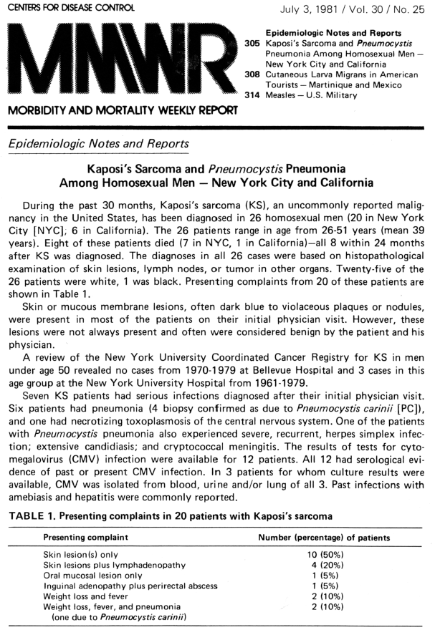
  In the US KS was 20,000 times more frequent among AIDS patients; up to 30% of AIDS patients developed KS before cART era.
  KS was recognized as the second epidemic.
  In 1994 Chang and collaborators identified HHV-8/KSHV in all KS cases and PBMC
  Swiss cohort:
    1985-1996 SIR 246 (95%CI 218-277)
    1997-2001 SIR 47.8 (95%CI 33.3-66.6)
    2002-2006 SIR 22.9 (95%CI 23-12.5)
Chan Y. Science 1994;266:1865-1869.
Martin JN N Engl JMed 1998;338:948.
S Franceschi, British Journal Cancer 2010.

Slide 4
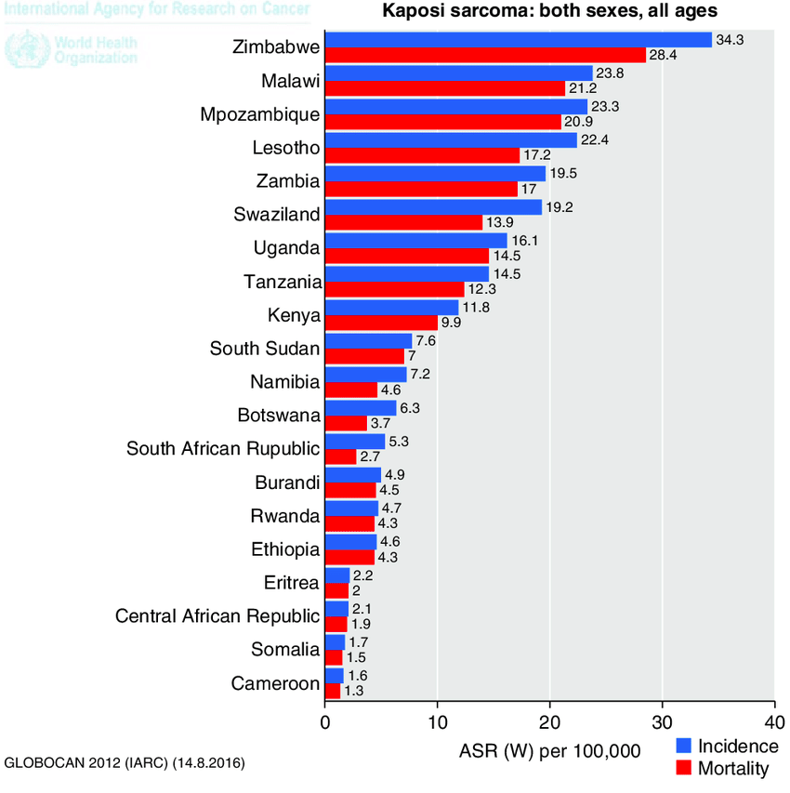
Kaposi Sarcoma in sub-Saharan Africa
The most frequent AIDS malignancy in
Sub-Saharan Countries.
HHV-8/KSHV prevalence in Uganda 69%
mothers, 15% children, Cameroon 82%,
Nigeria 24%, Tanzania 45% South Africa 11%
The KS incidence has increased due to high rates
of HIV and HHV-8/KSHV co-infection in the region.
Overall KS incidence rate was 164/100,000 pys
[95% confidence interval (CI): 151-178]
Botswana, South Africa, Zambia, and Zimbabwe.

Slide 5
Epidemic Kaposi sarcoma
Pathology:
  angiogenesis, inflammation and proliferation
    whorls of spindle cell with leucocytes infiltration and aberrant proliferation of small vessels that lack basement membrane
    Leaky behavior
    Micro hemorrhages and hemosiderin deposition
Skin, gastrointestinal tract, lung and lymph node involvement.
  Lymphedema
  Pleural effusion
Enigmatic and unpredictable course
  minimal disease as an incidental
  fast explosive, rapidly progressive disease with high mortality.

Slide 6
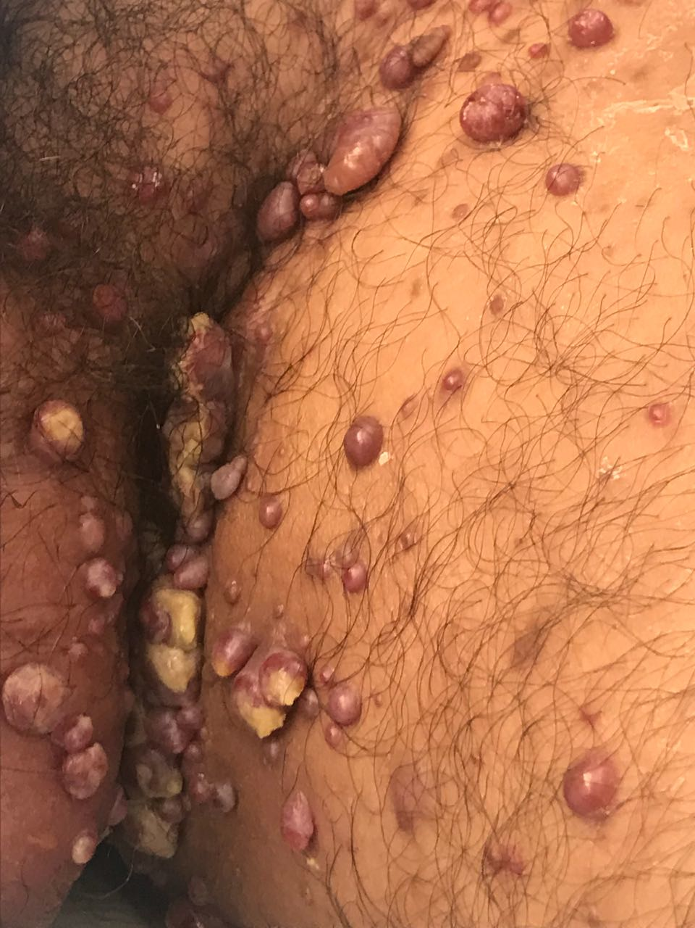
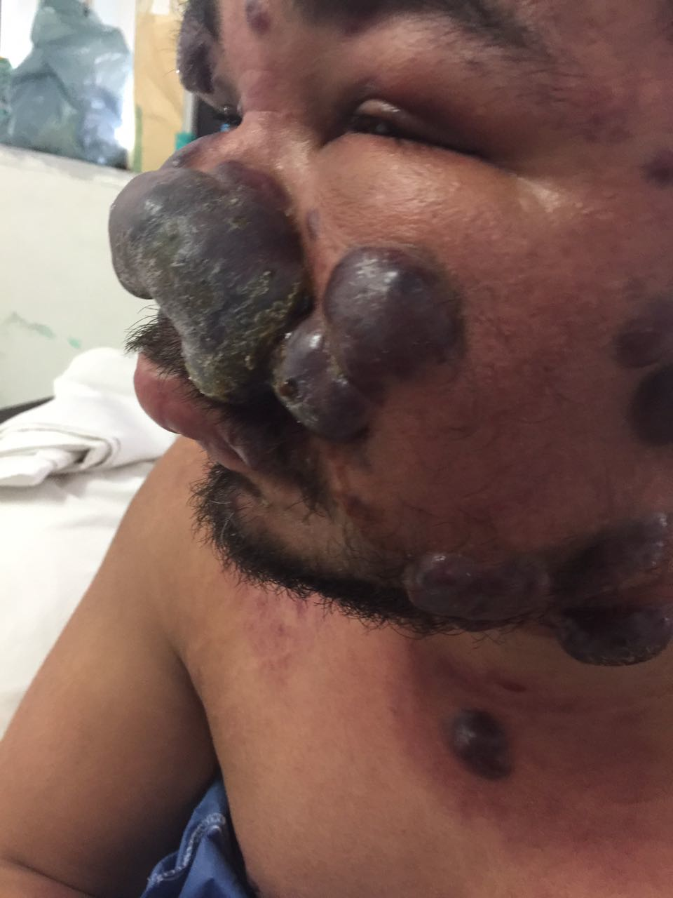
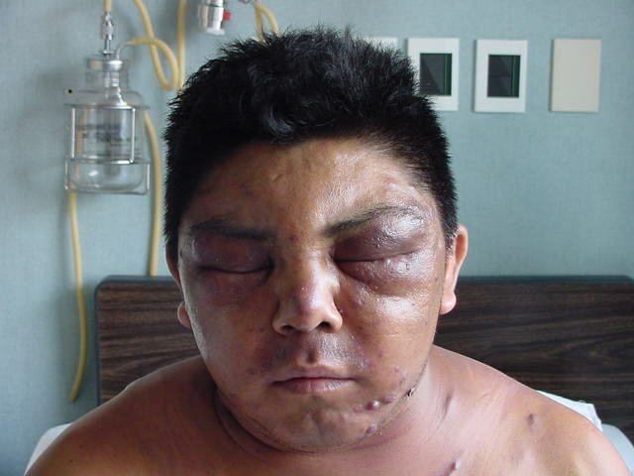

Slide 7
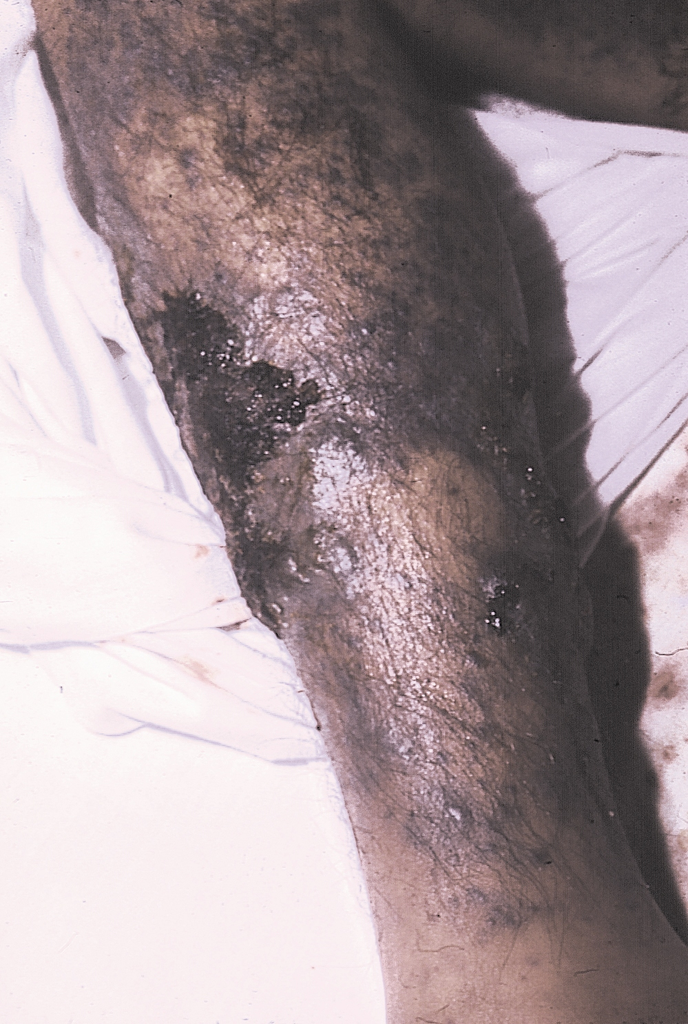
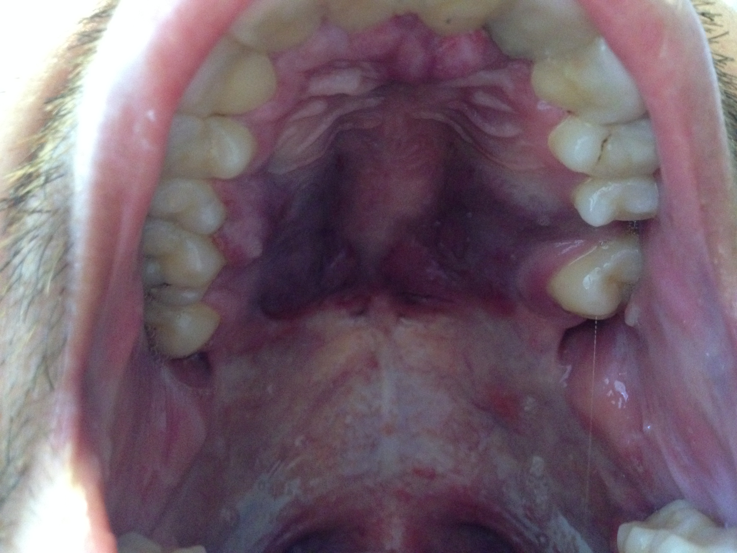
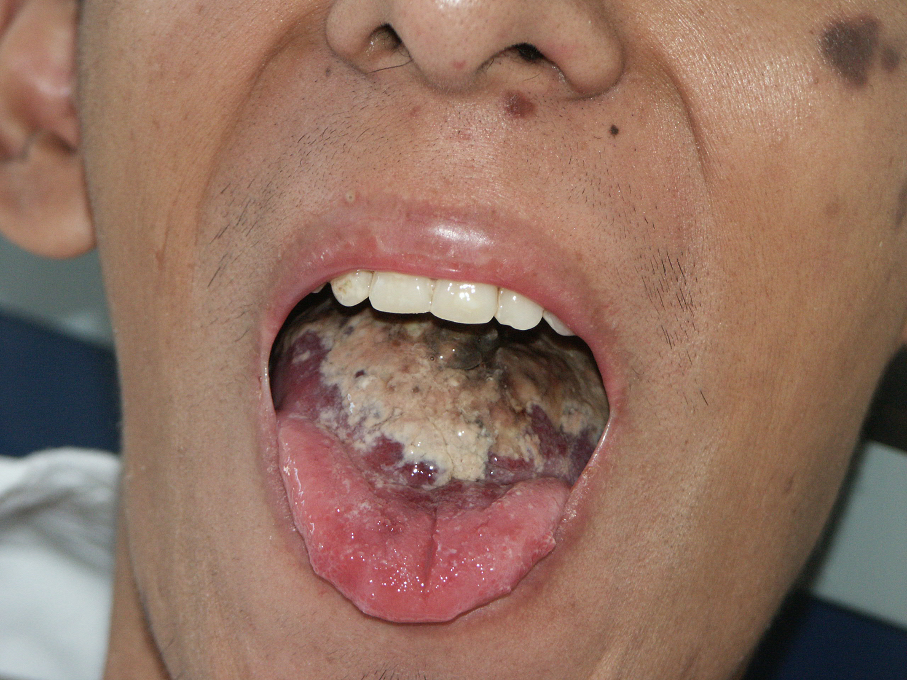
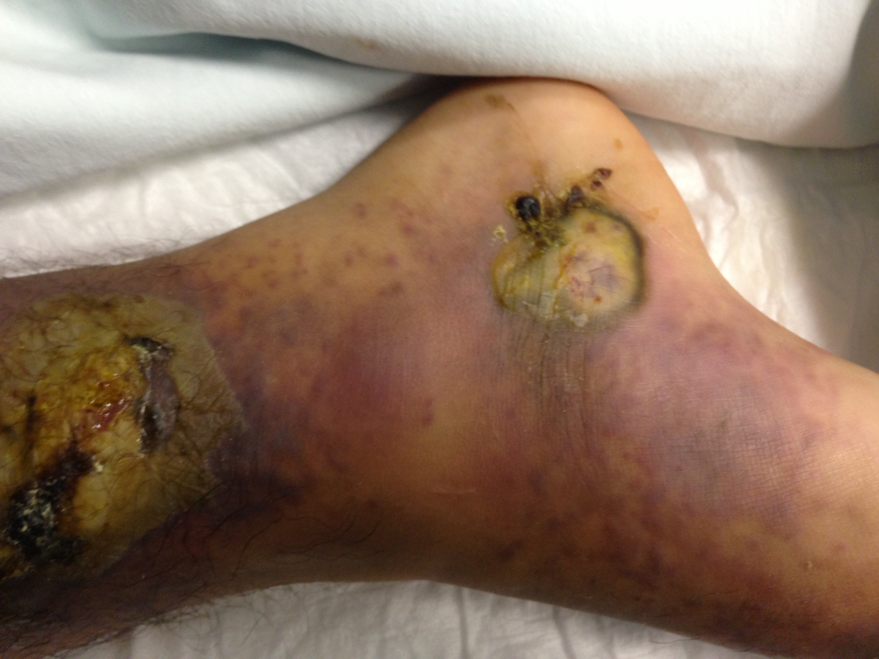

Slide 8
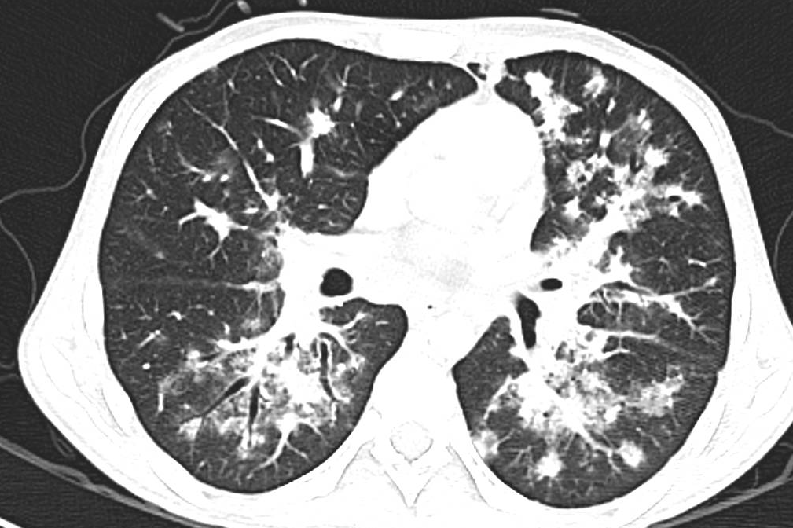

Slide 9
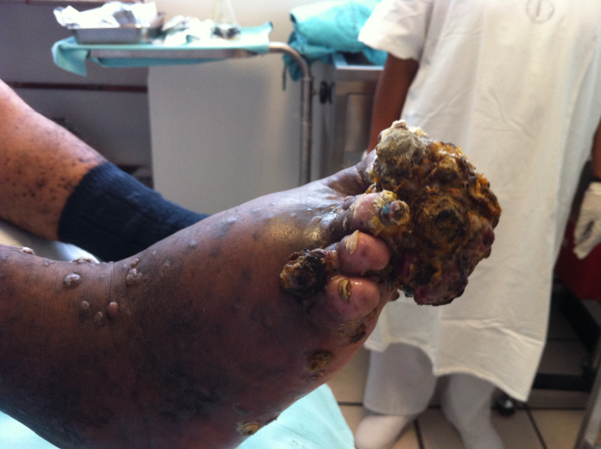
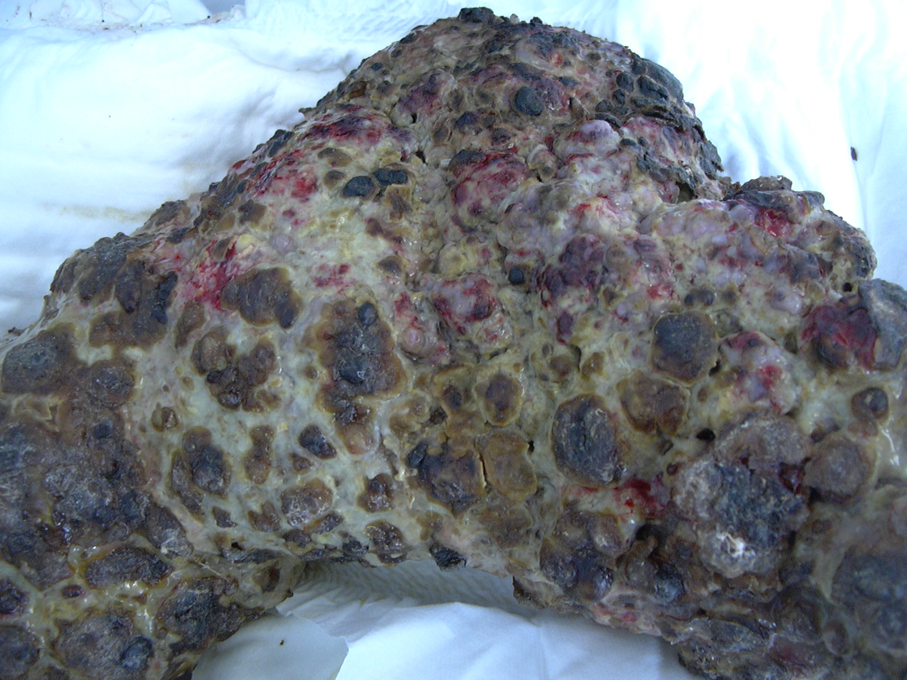
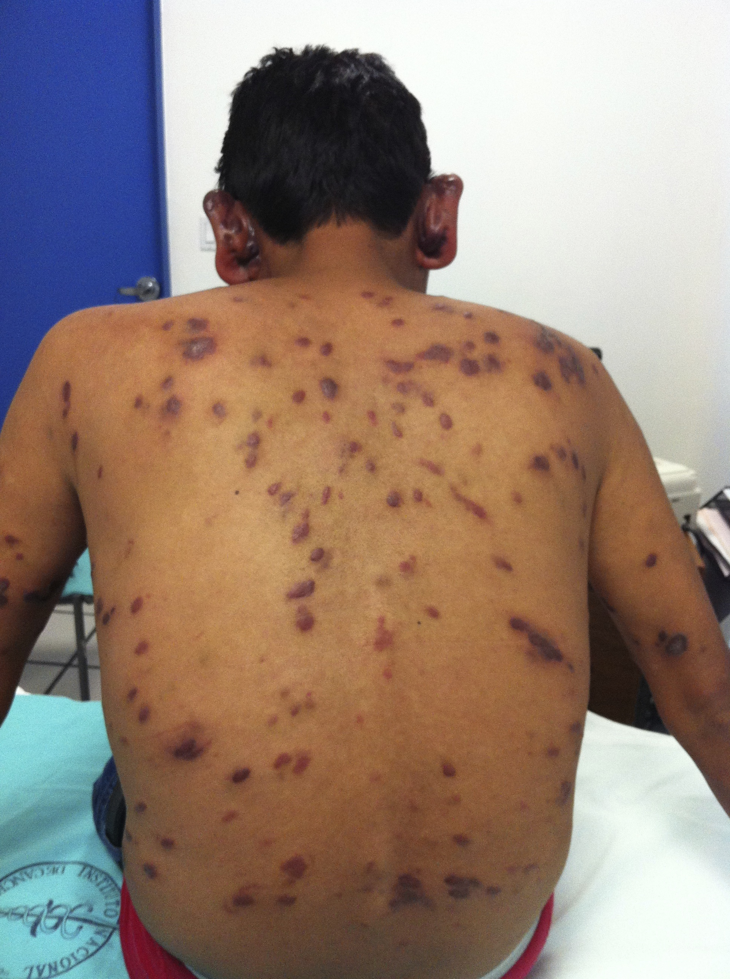
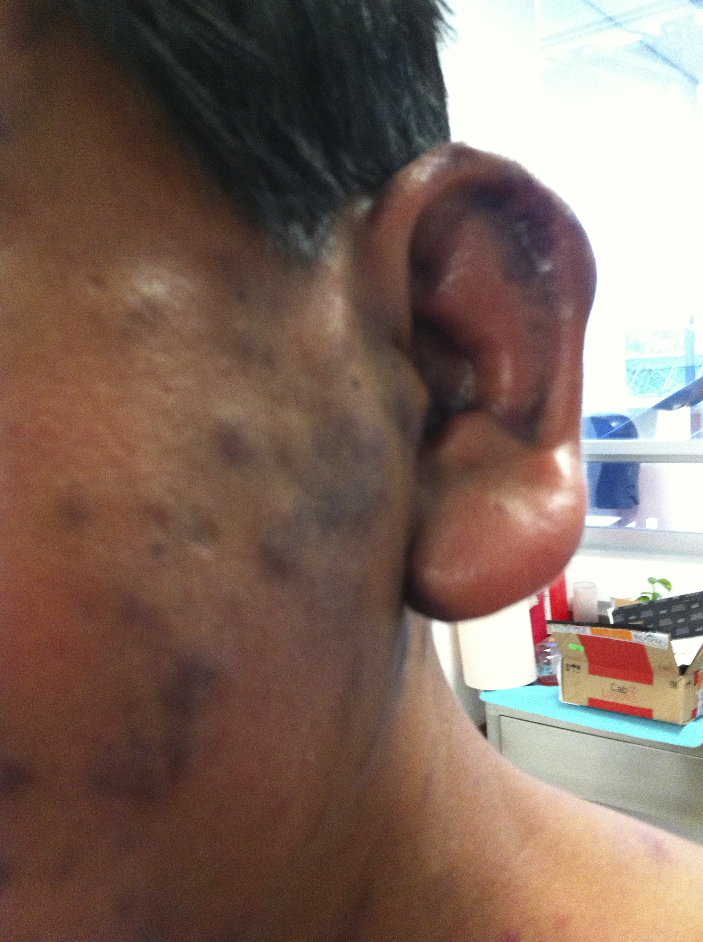
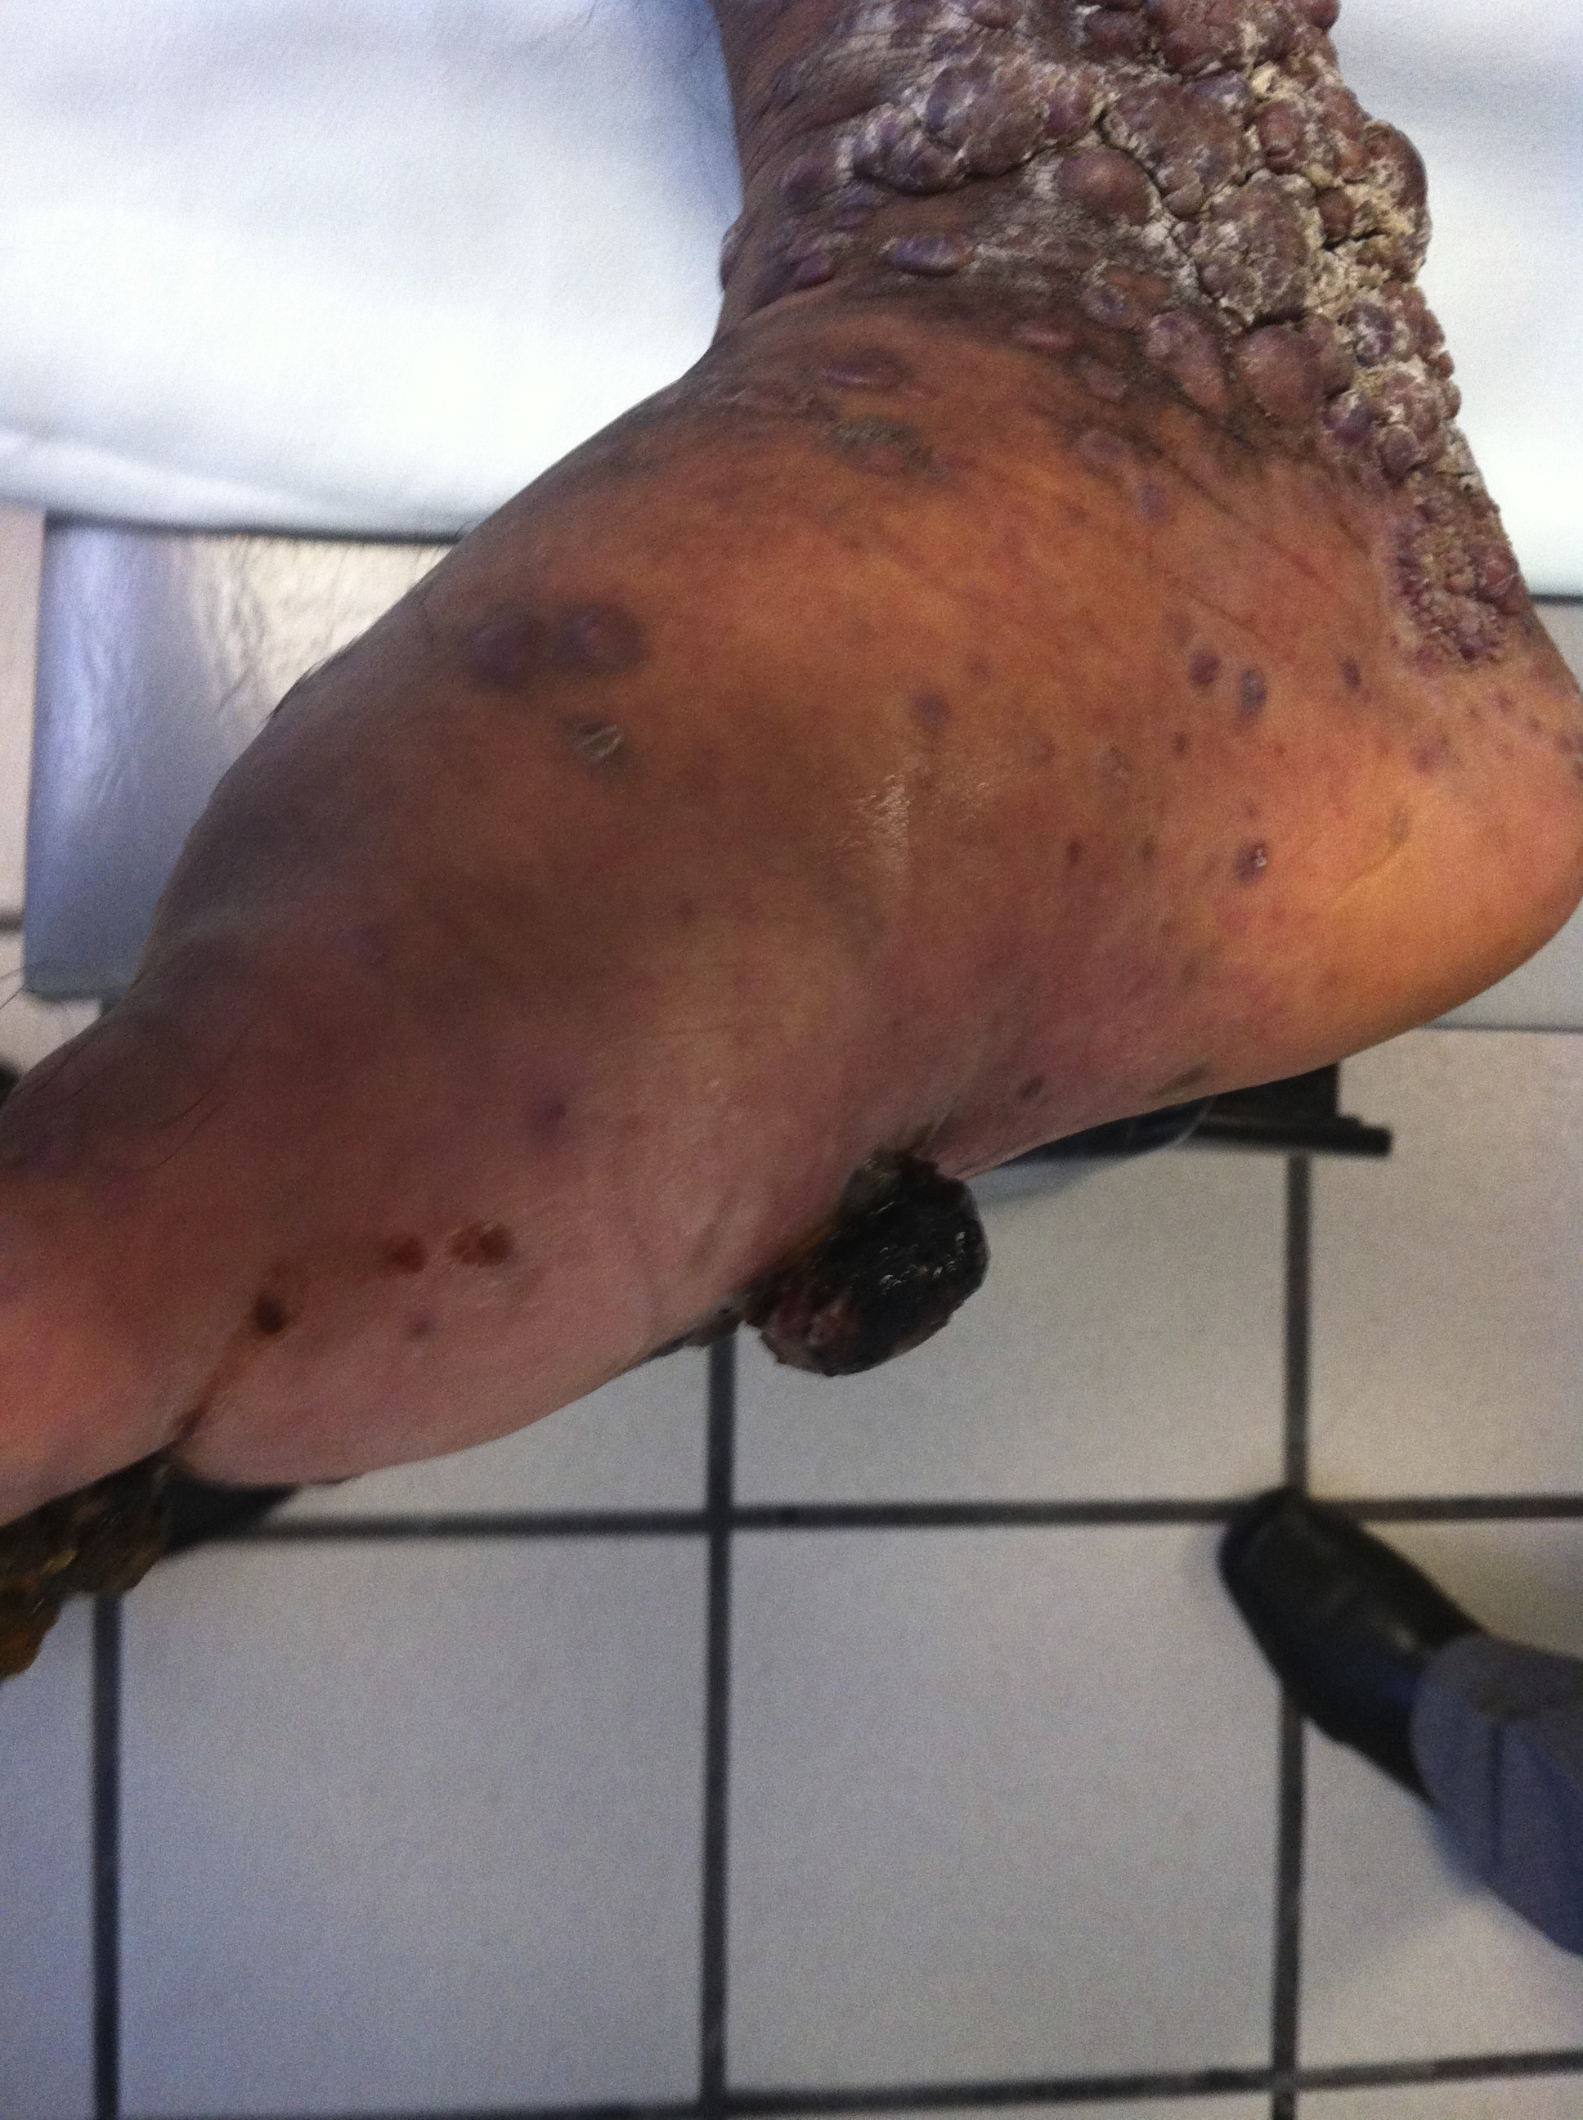

Slide 10
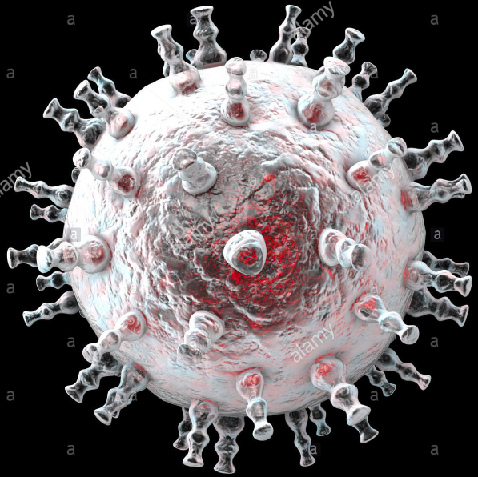
Human Herpesvirus 8 double-stranded DNA
Infects: B-cells, monocytes and endothelial cells
HHV-8/KSHV gene machinery (mimics human oncogenes)
Lytic
expresion of all genes,
Promotes replication and release of progeny virions and death of cells
Promotes cell division infected cells
Inhibits apoptosis,
Modulates inflamation,
Induces angiogenesis
Does not produce immortalization
Multicentric, multiclonal.
Latent
(LANA) p53
decrease apoptosis and
Increases survival of
infected cells
Evades host imune
  Inflammatory cytokines promote KS cell proliferation and differentiation
    (IL-6, oncostatin, alfa-TNF, PDGF, VEGR,)
    HIV-Tat protein induces expression of cytokines
    (N-kappa B activation, INF gamma VEGF)
https://www.alamy.com/stock-photo-kaposis-sarcoma-herpesvirus-kshv-computer-illustration-kshv-is-kaposis-127807938.html

Slide 11
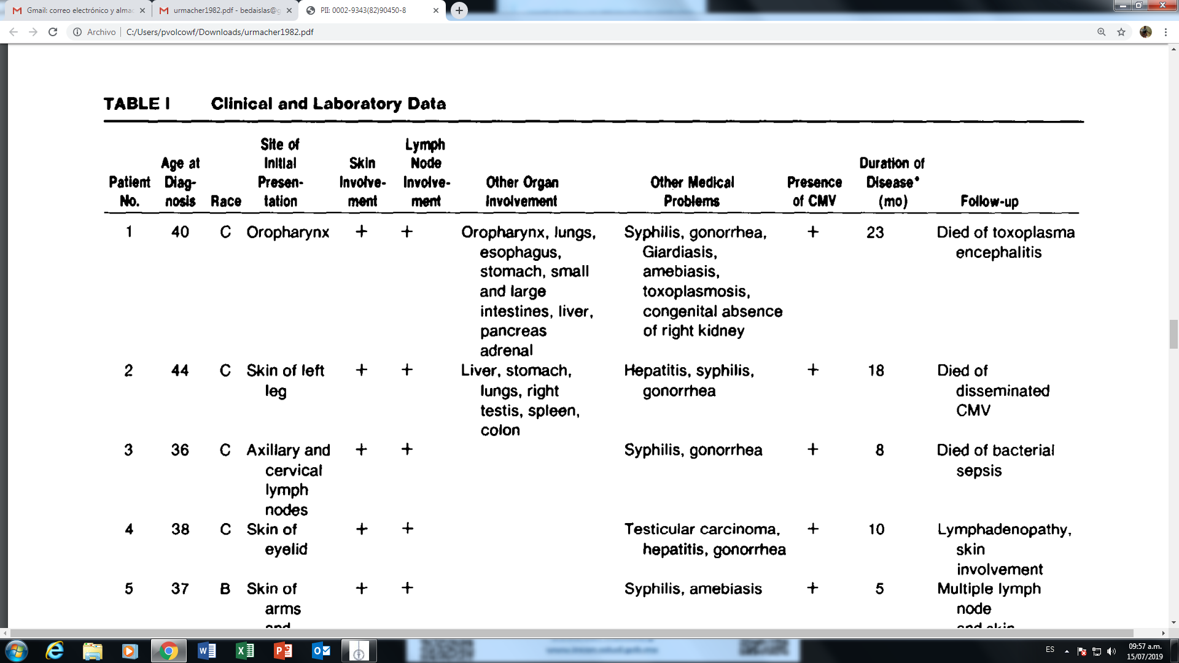
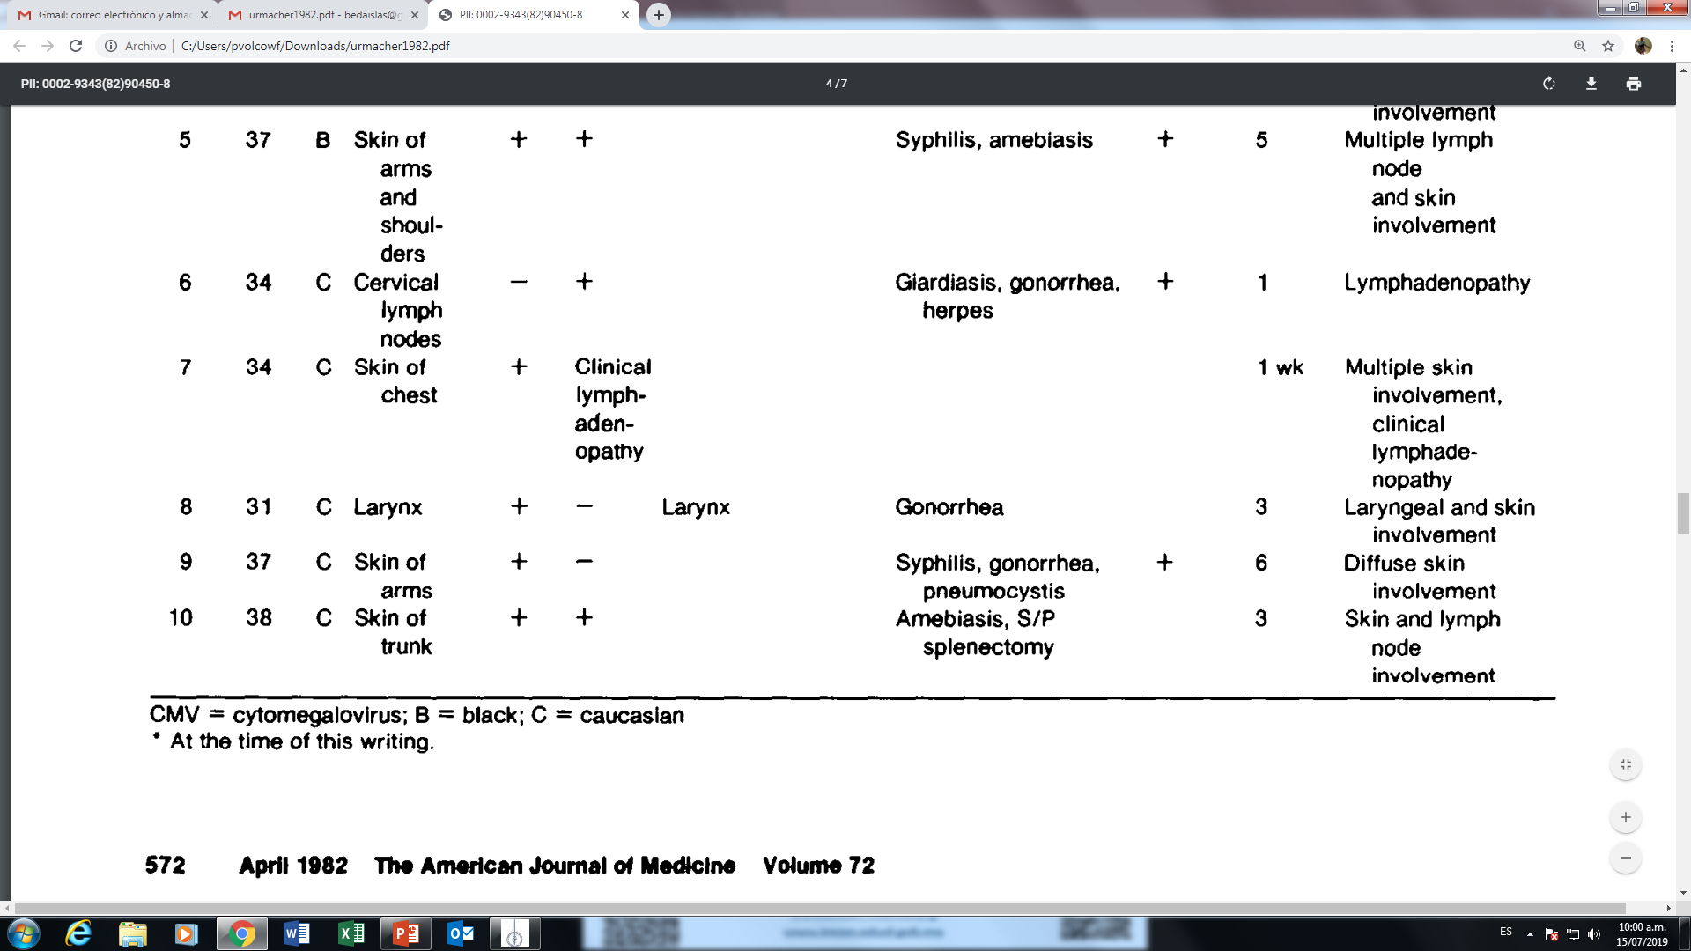
Urmacher C.
American Journal of Medicine, April 1982

Slide 12
Kaposi Sarcoma Therapy
European consensus-based interdisciplinary guideline.
T₀I₀S₀ GOOD PROGNOSIS
Confined to skin and lymph nodes, minimal oral disease.
>150cells/ml
No OI or thrush
cART only
T₁I₁S₁ POOR PROGNOSIS
Extensive oral involvement, Lymphedema, or ulceration,
GIT-KS
Pulmonary KS
<150cells/ml
History of OI, thrush
B symptoms
IRIS-KS
cARt + Chemotherapy
Lebbe C European J. of Cancer 2018

Slide 13
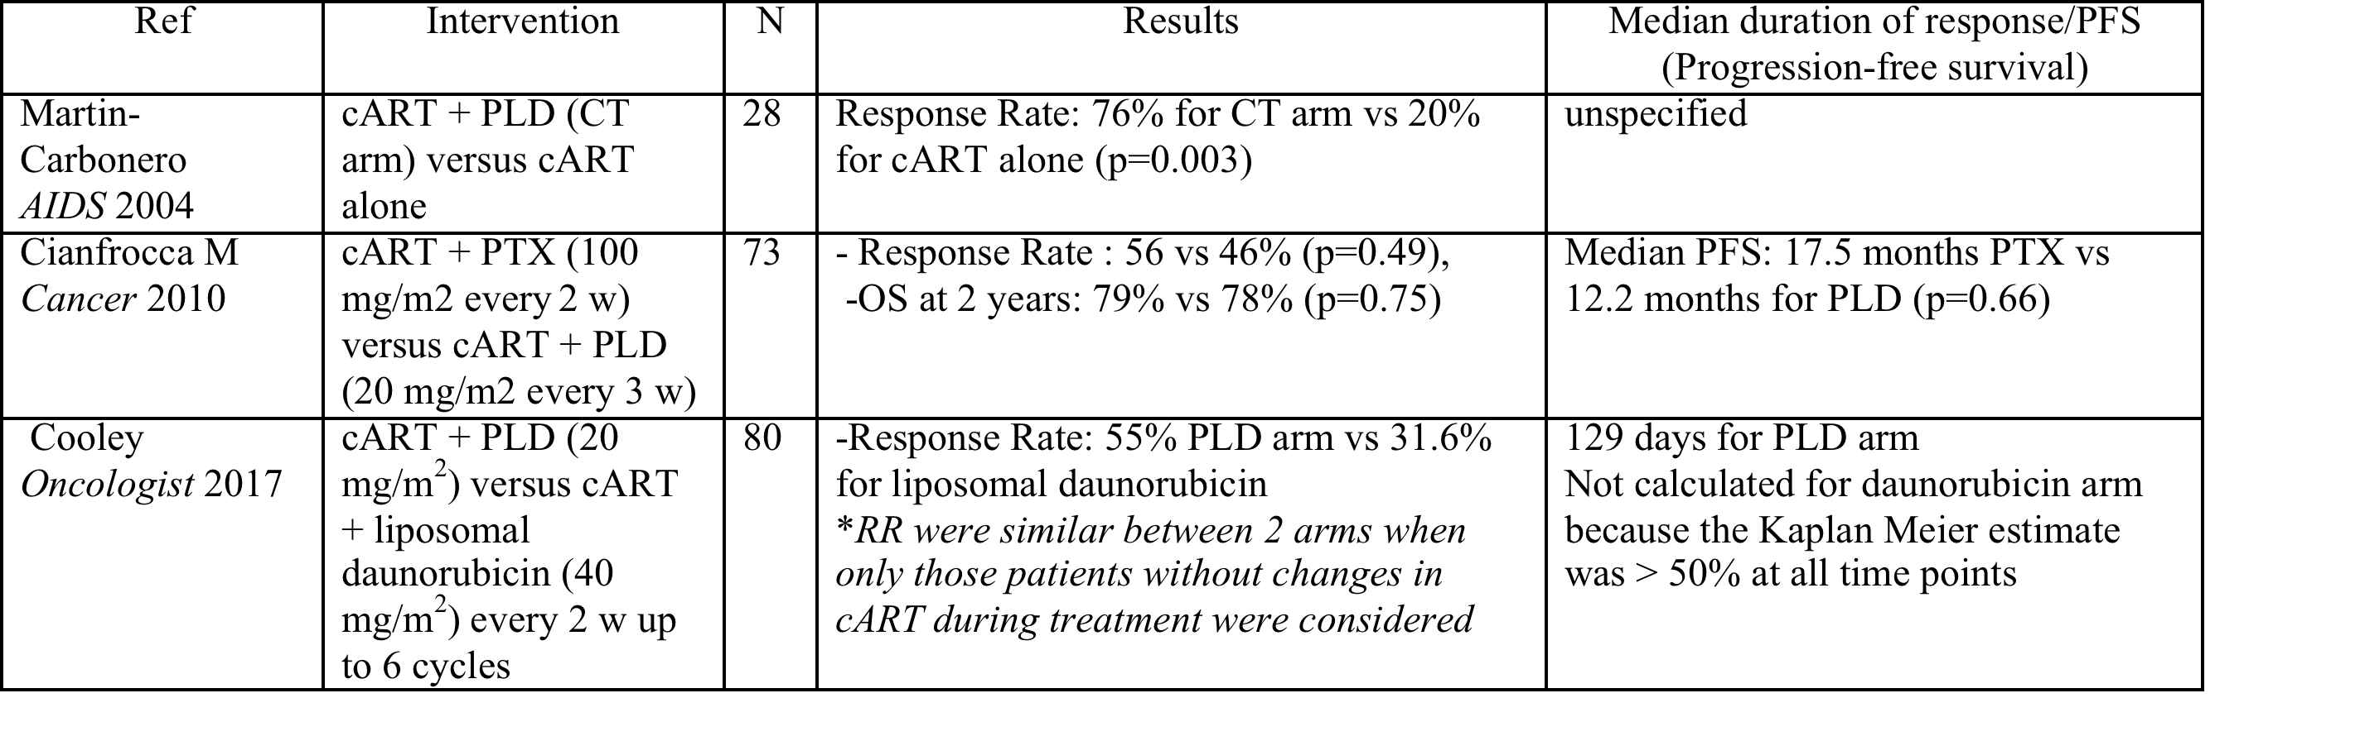
Systemic treatment for AIDS-related Kaposi-phase III trials
European consensus-based interdisciplinary guideline.
The goal of systemic therapy is not to cure but to achieve disease control and symptom relief with quality of life preservation.
Lebbe et al. European Journal of Cancer 2019.

Slide 14
Overall survival in weeks after cART initiation for patients with and without Immune Reconstruction Inflammatory Syndrome (IRIS-KS).
39% of naive patient starting cARV developed IRIS-KS
Aids Res Ther 2017; 14: 30

Slide 15
Outcome at last follow-up of patients with Kaposi Sarcoma comparing treatment regimen
Chemotherapy regime= Bleomicyn and vincristine (1 to 4 cycles)
Median time of follow-up of 81 patients surviving over 26 weeks after cARV initiations was 52 months (sd 27.4m.)
Volkow et al. AIDS Res Therapy 2017.

Slide 16
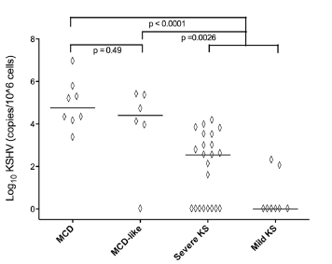
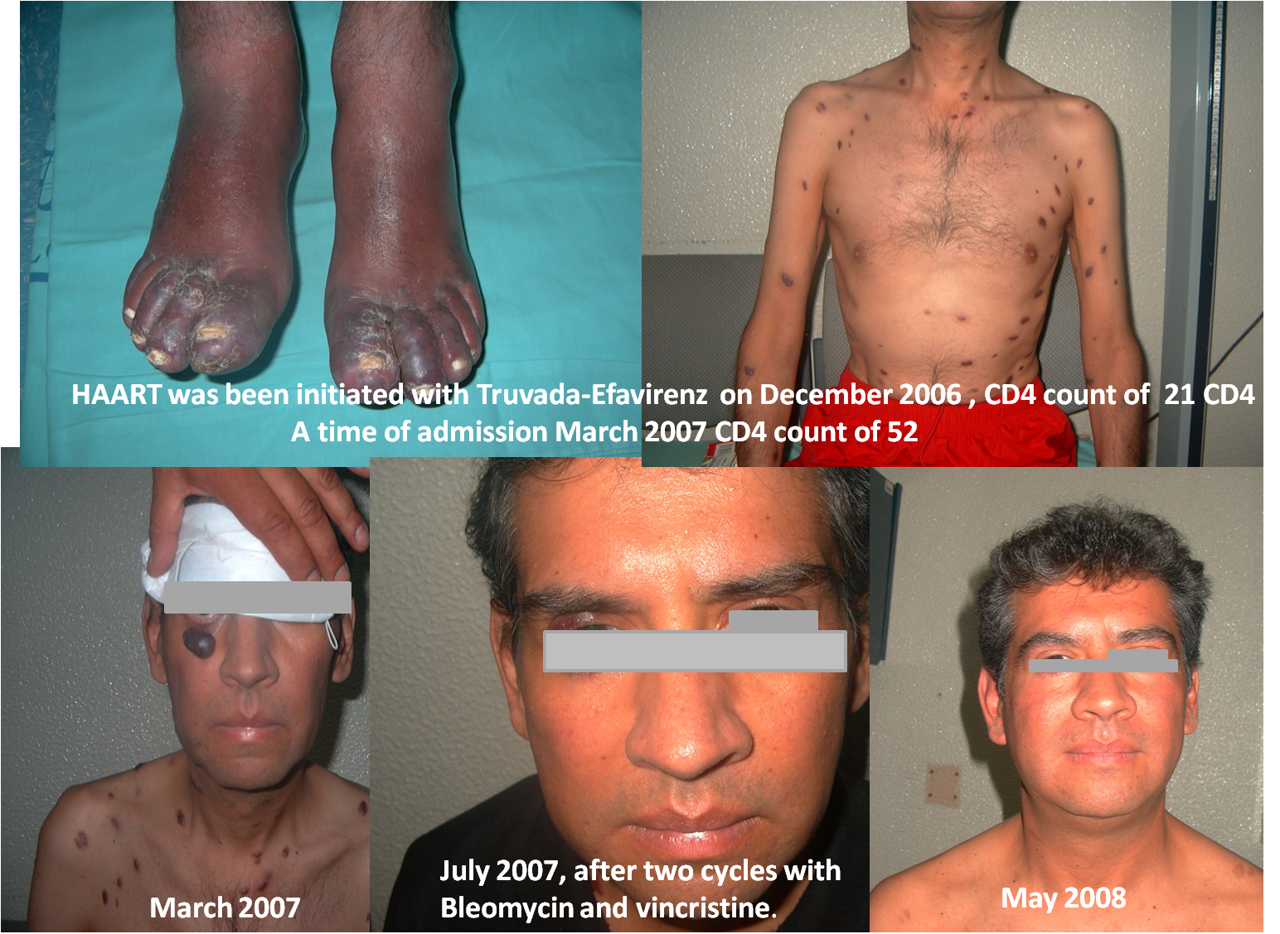
High HHV-8/KSHV Viral Loads Correlate with Disease Severity
        Uldrick TS Clin Infect Dis 2010; 51(3):350–358.

Slide 17
Potential Role of Ganciclovir in KS?
      Ganciclovir active in vitro against HHV-8/KSHV
        Neyts J. Antimicrobiak Agents Chemotherapy 1997:41: 2754
      Ganciclovir reduced KS risk when it was given for secondary prophylaxis
        Glesby MJ J Infect Dis 1996; 173: 1477
      Ganciclovir reduces oropharyngeal HHV-8 replication
        Casper C. JID 2008,198:23.
    Thus, we hypothesized that Gancilovir (prodrug Valganciclovir) would be therapeutically beneficial in the treatment of KS.

Slide 18
Open Label RCT of Valganciclovir before cART compared to cART (Vincristine and Bleomicyn as needed*)
Valganciclovir 900mg BID
Experimental
cART
Control
cART
0 1 2 4 8 12 16 24 48
Weeks
*Chemotherapy: Vincristine 2 mg and Bleomicyn 15 US
Initially: Extensive KS compromise before starting cART and/or Oro-pharyngeal lesions
Follow-up: In cases of Severe IRIS-KS
  Extensive KS without IRIS-KS
Clincal Trails NIH ID NCT03296553.
IRB: INCan (015/031/INI) (CEI/950/15)
Notes:
Registro NIH ID NCT03296553.
Aprobado por el comité de ética del INCan (015/031/INI) (CEI/950/15)

Slide 19
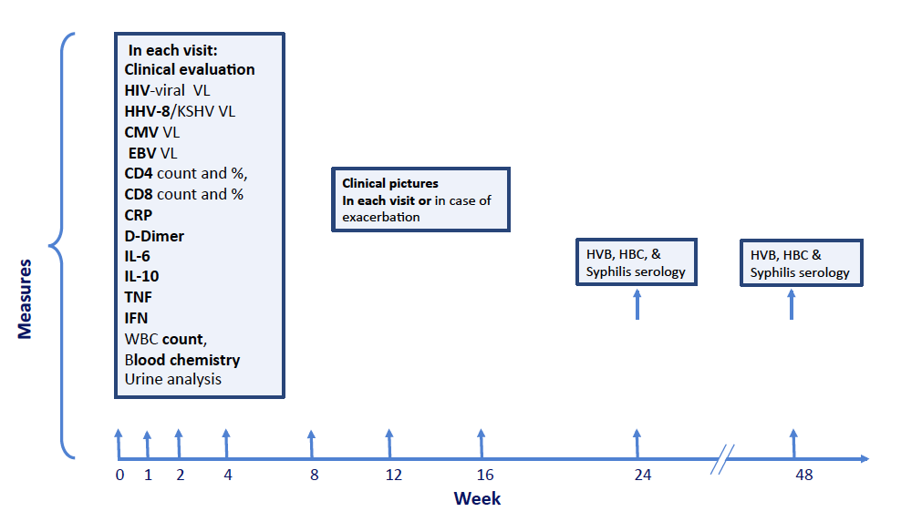
Study Timeline

Slide 20
Clinical Evaluation and Enrollment Criteria
Exhaustive research to diagnose co-infections
Bone marrow culture and bone biopsy
Serology for Syphilis, HBC, HVC
Histoplasmosis
If indicated LP
Tuberculosis: GenXpert of sputum or biopsy specimen
Cryptococcus antigen
Ophthalmologic evaluation
Upper GIT endoscopy
Colonoscopy if patient had diarrhea or bleeding
Chest Ct Scan (neck, thorax and abdomen)
Biopsy and culture of enlarged lymph nodes
Bronchoscopy with BAL if indicated
Thorax Gallium scan or PET if required.
Inclusion criteria:
  AIDS cART naïve patients with disseminated Kaposi Sarcoma (pulmonary disease and/or 30 skin lesions, and/or lymphedema and/or lymph node involvement and/or GIT involvement, (biopsy proven only one site needed).
  Provide signed inform consent.
Exclusion criteria:
  Any other malignant disease.
  Castleman´s disease
  Patients receiving steroids for the last two months previous to screening.
  Active Hepatitis B or C.
  CMV end organ disease; APACHE >15

Slide 21
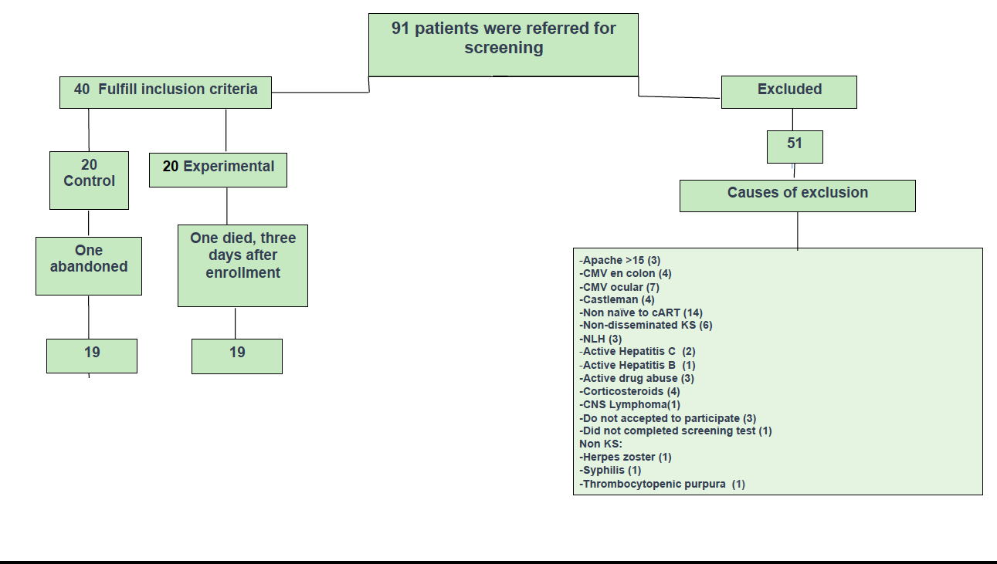

Slide 22
IRIS-KS criteria
Non severe IRIS
Abrupt increase in the size or number of KS lesions,
appearance or exacerbation of lymphedema.
At least one of the following criteria
at least 1 log10 of HIV-1 RNA
decrease an increase of ≥50 cells/mm³
or ≥two fold rise in baseline CD4+ cell
Severe-IRIS
(abrupt clinical deterioration after starting cART
At least two of the following :
  Fever (no documented infection)
  abrupt increase in the size or number of KS lesions or exacerbation of lymphedema, or
  increase of otherwise unexplained lung opacities on chest X-rays Ga Scan negative.
  Pleural effusion
Abrupt appearance of at least three parameters:
thrombocytopenia <100,000 platelets/ml;
Anemia
Hyponatremia
Hypoalbuminemia

Slide 23
 | Total 40 | % | EXPERIMENTAL 20 | % | CONTROL | 20 | P
MAC | 4 | 10 | 3 | 15 | 1 | 5 | 0.29
HISTOPLASMA | 7 | 17.5 | 5 | 25 | 2 | 10 | 0.21
SIFILIS | 10 | 25 | 4 | 20 | 6 | 30 | 0.46
NEUROSIFILIS | 3 | 7.5 | 2 | 10 | 1 | 5 | 1
PARASITES | 3 | 7.5 | 1 | 5 | 2 | 10 | 0.54
H.PYLORI | 7 | 17.5 | 4 | 20 | 3 | 15 | 0.67
PCJ | 2 | 5 | 1 | 5 | 1 | 5 | 1
Co-infections | 30 | 75% | 15 | 75 | 15 | 75 | 1
At least one Herpes virus coinfection | 40 | 100% | 20 | 100% | 20 | !00% | 0
Log KSHV/HHV-8 | 7.9 | 2.7 SD | 8.31 | SD 2.2 | 7.56 | SD 3.1 | 0.8
Log VIH | 11.75 | 2.32 SD | 11.75 | SD 1.8 | 11.7 | SD 2.8 | 0.49
Log CMV | 5.8 | 2.55 | 5.56 | SD 2.05 | 6.08 | SD 3 | 0.26
Median CD4 Cells/ml | 69 | IQR 36-119 | 71 | 34-110 | 62 | 38-145 | 0.49
Mediam CD8 Cells/ml | 715 | IQR 395-1178 | 799 | IQR 499-1226 | 668 | IQR 343-119 | 0.4
Hb | 11.75 | IQR 10-13.5
Platelets | 176500 | IQR 139000-262000 | 183500 | IQR 126500-2925003 | 172000 | 141500-225000 | 0.43
Albumin | 3.3 | IQR 3-3.9 | 3.65 | 3-3.8 | 3.55 | IQR 3-4 | 0.53
Sodium | 137 | IQR 134-140 | 137 | IQR 133-140 | 136 | IQR 134-140 | 0.29
DD | 1435 | IQR 888-2922 | 1695 | IQR 965-3525 | 1165 | IQR 628-2410 | 0.39
CPR | 1.3 | IQR .68-2.8 | 1.16 | IQR 0.74-2.5 | 1.19 | IQR 0.64--3 | 0.68

Slide 24
Kaplan-Meier of Survival by Group
Log rank p=0.855
All deaths in control group attributable to IRIS-KS, experimental one Influenza H1N1 and opioid overdose.

Slide 26
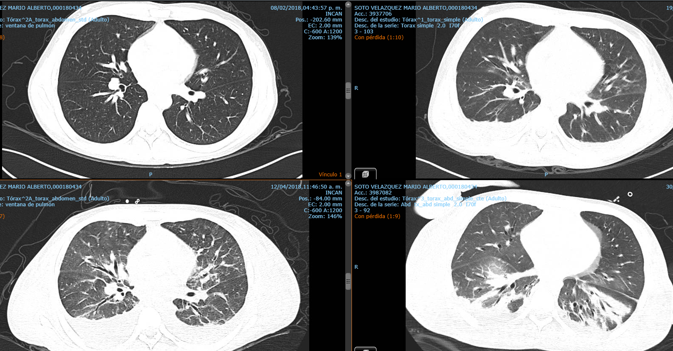
Baseline
WEEK 3
WEEK 7
WEEK 10
Notes:
SOTO VELAZQUEZ MARIO

Slide 27
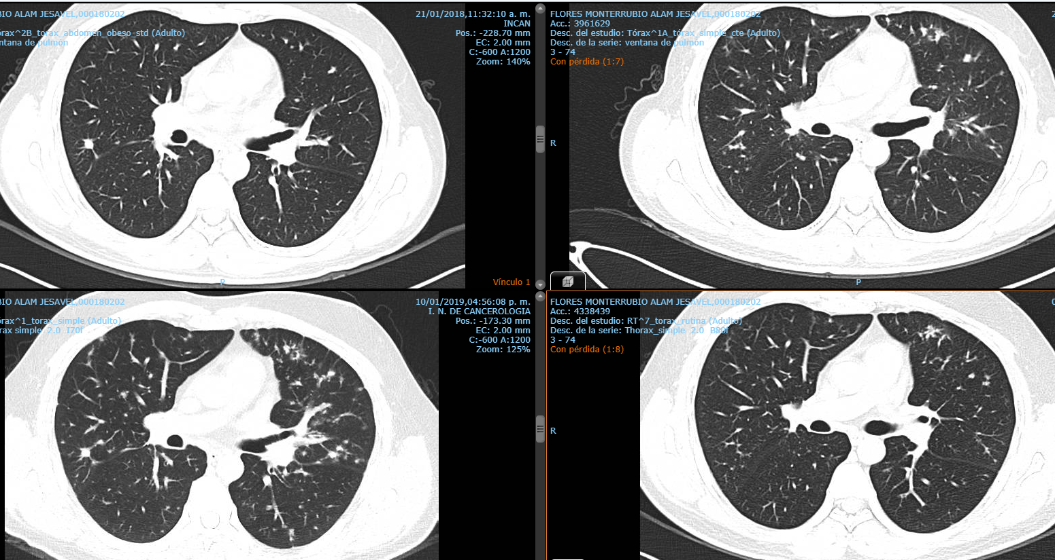
WEEK 12
WEEK 0
WEEK 48
WEEK 64
Notes:
ALAM

Slide 28
Conclusions
AIDS patients with DKS should be thoroughly evaluated to investigate and treat co-infections.
Measurement of HHV-8/KSHV viral load should be standard in the care of patients with DKS
In patients with >1000 copies/ml of HHV-8/KSHV valganciclovir can be beneficial in decreasing IRIS severity and IRIS attributable mortality.

Slide 29
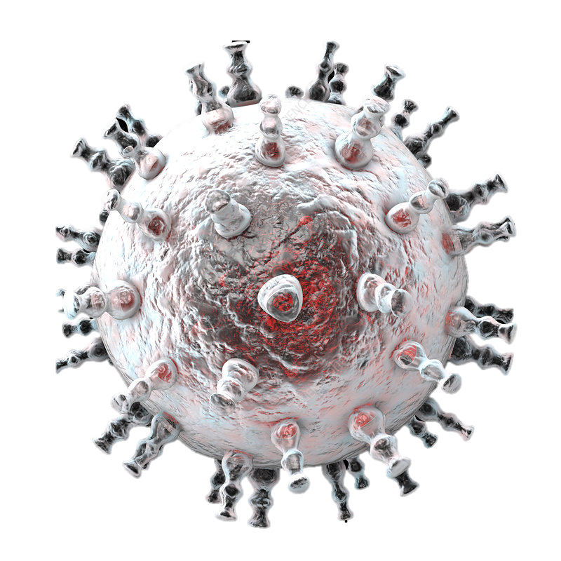

Diagnose & treat
co-Iinfections
bacterial, fungal, parasitic, virus
and mycobacterial
Anti-KSHV THERAPY
Diminish KSHV VL
Valganciclovir
cART suppress HIV and Tat production, restitute immune function .
IRIS
Stop spindle cell proliferation
MTA
Avoid myelosupressive drugs
Latent
Lytic activity
Kaposi Sarcoma
Severe-IRIS, after TARc
Thrombocytopenia
Anemia
Hypoalbuminemia
Hyponatremia
Pleural effusion +-
Massive lymphedema+-
HHV-8/KSHV viral load
Full gene expression,
host cell machinery to
Produce virions
P53
Inhibits apoptosis
evades cell host response
increase survival survival
RTA
Oxidative stress
Cytokines
IL6 vIL6 INF-g
VEGF PDGF oncostatine
Hypoxia
Coinfections
Bacterial,
Virus
Fungus
Parasites
Tat
HIV
Immunodeficiency

Slide 30
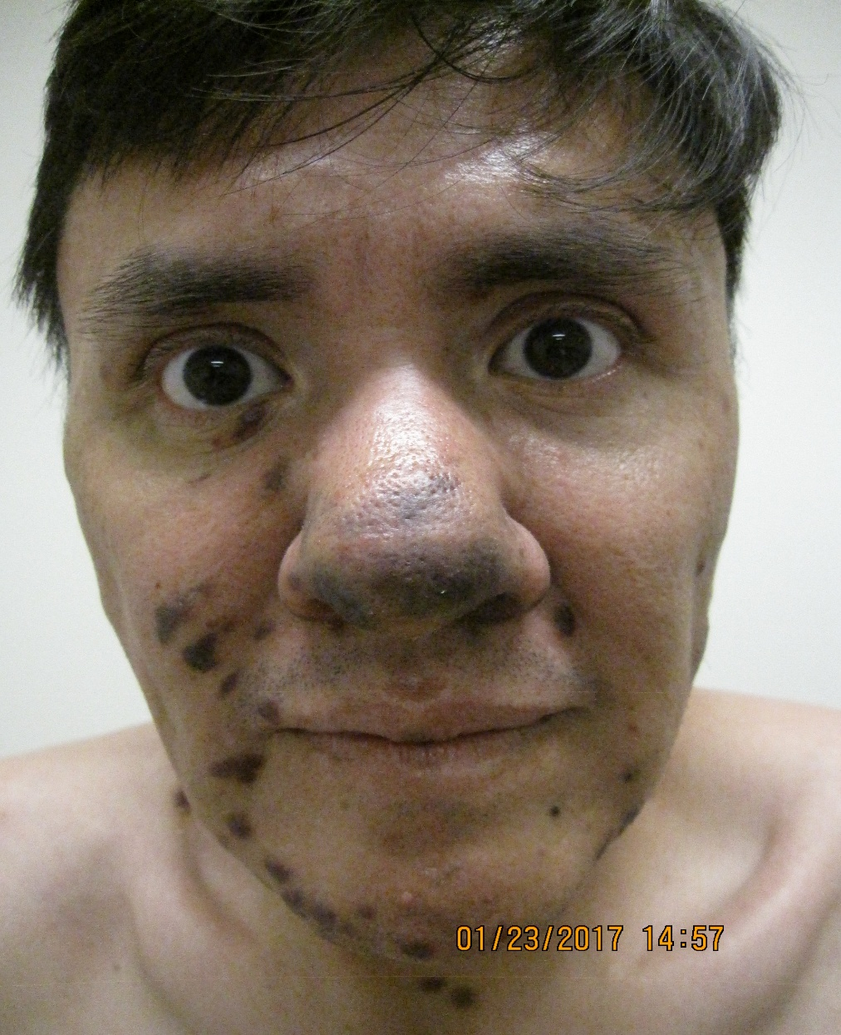
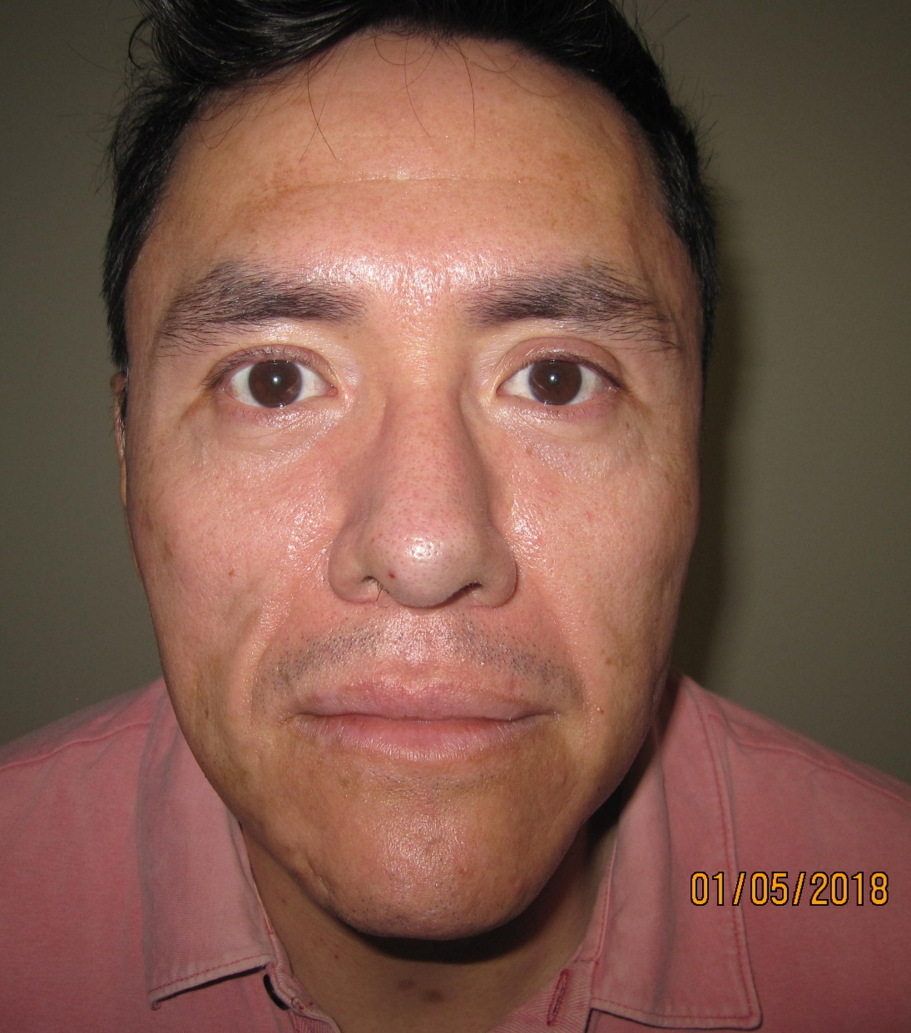
Baseline visit
Week 48

Slide 31
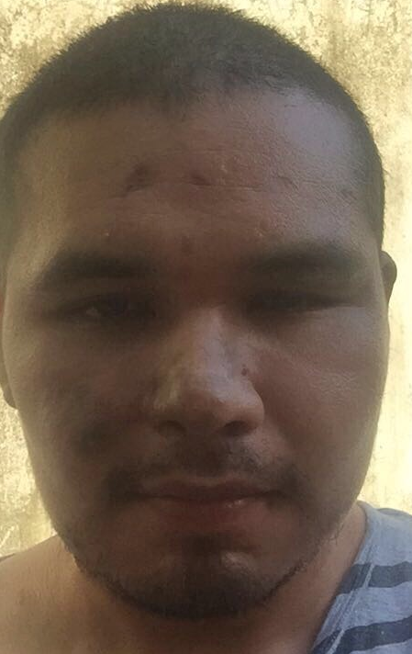
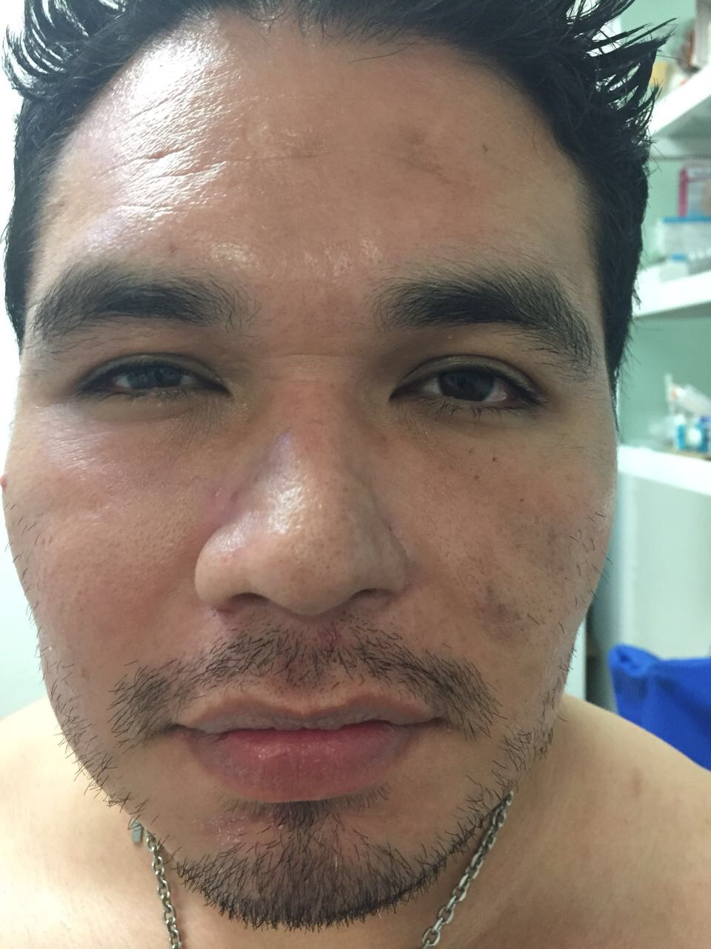

November 2016
March 2017
July 2017
March 2018

Slide 32
Acknowledgments
Beda Islas Muñoz
Leslie Chávez Galán
Lucero Ramón
Judith González
Rogelio Pérez Padilla
Patricia Cornejo Juárez
Flavio Grimaldo
Diana Vilar Compte
Claudia Campos
Carmen Lome
Daniel de la Rosa
Arturo Martínez
Gustavo Rosales
Erick Osorio
Alexandra Martin-Onraet
Isabel Sada
Lucero González
Juan Zinser Sierra
Maria Delia Perez
To patients, their mothers and partners for their unconditional support.
This study was funded by the Mexican Congress Equity & Gender Commission

